Slide 1
Clinical Audit and Registries Management Service
Supporting Better Care
Presented by:
Julie Michalowski – Audit Manager
Alex Newsome – Service Delivery Manager

Slide 2
Agenda
Who we are
Audit and registry portfolio
Clinical Audit Platform
How IT achieves high quality data
Outputs to support quality improvement
Barriers and facilitators
Notes:
Two reasons behind developing this seminar

Slide 3
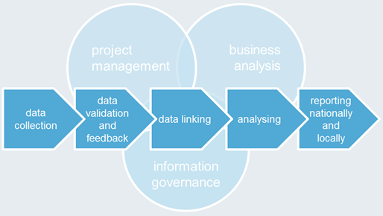
CARMS - Who we are
End to end service to provide information to facilitate quality improvement - dataset design, development, collecting data, analysis and publishing reports.
Commissioned by various organisations, including government and charities. We work in partnership with professional bodies (HQIP), Royal Colleges, universities and patient groups.
Projects vary in size from small pilot projects to large national audits and include both primary and secondary care.
Information analysts and statisticians, who validate and analyse data, provide data quality feedback and answer data queries.
Produce reports, including local action plans. Published in formats that make them accessible for different groups e.g. patient friendly, PowerPoint templates for onward use.
Notes:
Notes:
Includes making recommendations, developing action plans and monitoring quality improvement in next audit cycle.
The service can be tailored to the requirements of each new project.
Access to wider stats experience in NHS Digital
Work closely with NHS Digital IG teams - legal basis for collection, security of systems, fair processing.
Diabetes success with patient focussed reports, identifying findings / recommendations and actions. At a glance gives a view of what can be done.
Clinicians and other health care professionals;
Patient groups;
Government e.g. DH, NHS England;
Charities and academia;
Medical royal colleges;
Other NHS Digital teams e.g. Commercial, Information Governance, IT development.

Slide 4
Audit and registry portfolio
Assuring Transformation (AT – collection)
Breast and Cosmetic Implant Registry (BCIR)
Bowel and Oesophago-Gastric Cancer Audits (NBCA and OG)
Chronic Obstructive Pulmonary Disease Audit (COPD)
Female Genital Mutilation Enhanced Dataset (FGM)
Inflammatory Bowel Disease Registry (IBD)
National Audit of Cardiac Rehabilitation (NACR)
National Audit of Pulmonary Hypertension (NAPH)
National Diabetes Audit (NDA)
National Diabetes Foot Care Audit (NDFA)
National Diabetes Inpatient Audit (NaDIA)
National Pregnancy in Diabetes Audit (NPID)
National Third Molar Audit (N3MA)
Out of Area Placements (OAP – interim collection)
Safety Thermometer
Notes:
Traditionally audit, but now we are doing registries as well. The flexibility and security of CAP has meant we’re attracting more registry work and this facilitates direct patient care.

Slide 5
Clinical Audit Platform (CAP)
In-house development team
Validation rules
Web forms – direct data entry
Reports
Patient identifiable data – security controls
Operational management expertise & service wrapper
Notes:
CAP is built and supported by in-house development team so we can determine what we do. This allows us to create functionality to meet the specific audit / registry needs e.g. dataset items, specific validation rules to help with data quality. The in-house team also gives us flexibility on our priorities which is useful when we are trying to balance a number of different customer contract deliverables and requests.
2 methods of data entry – via the CAP web forms and via the file submission. File submission is useful for bulk upload but also we work with 3rd party system suppliers e.g. Somerset Cancer Registry, so they can develop a specification for the clinical systems that can then allow an easy upload into CAP.
There are a variety of extracts and reports for users – which again we can decide what is needed based on customer requirements.
PID – so security is a key aspect due to the nature of data contained. We work closely with Information Security, IG and IT Dev and have regular reviews of security policies and risks. We also have regular tests for security vulnerabilities which is carried out by an independent 3rd party.
Requirements we meet – corporate policies and structure, IG sign off on CAP processes and relevant functionality, Info Sec about cyber security.
We have a formal service wrapper around CAP so that there is strong governance e.g. we have service management board, we follow corporate incident and release management processes. CONTROLS
NOW GOING TO SHOW SOME EXAMPLES BUT PLEASE COME AND SEE US AFTERWARDS FOR A DEMO OF THE SYSTEM.

Slide 6
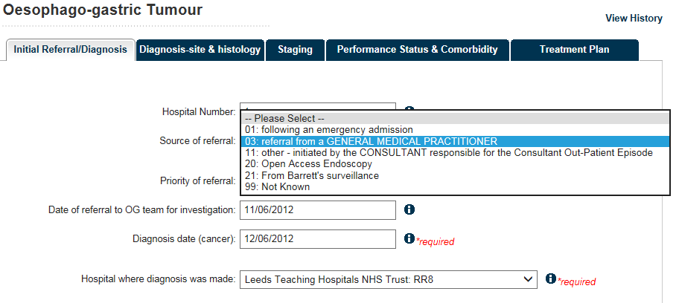
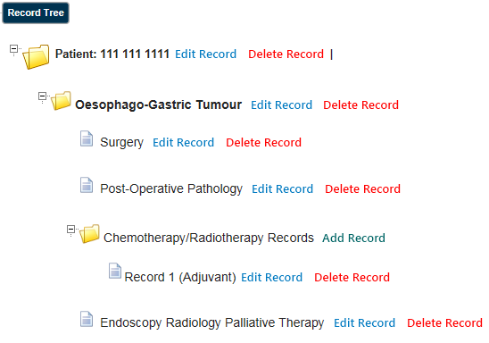
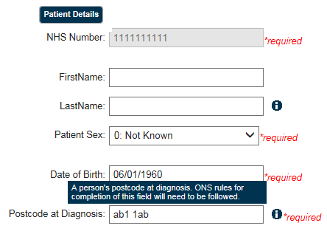
Clinical Audit Platform (CAP)
Notes:
Some examples…
Record tree – shows the navigation of the system, so users can always see what records have been entered and where applicable CAP will show key dates e.g. diagnosed date. This helps with knowing whether the record is to be updated, also a quick screen which directs user to next stage e.g. ‘Add chemotherapy / radiotherapy record’.
CAP always has a core patient record and all other records hang off this. This again helps with navigation and prevents duplication of patients. Greyed out shows you can no longer edit these fields, which helps safeguard data quality. Asterisk and help text appears to show where there is a required field and also help on what that field means.
Again will have greyed out, required and help text support. The records under patient then contain bulk of data items, collecting about the specific disease / condition topic. Different validation can occur e.g. ensure date field only accepts valid date format. Also a number of fields have drop downs, with populated reference data. This means consistency of data entry and codes.
CAN SHOW YOU CAP IN SESSION LATER THIS AFTERNOON IF YOU’D LIKE TO LOOK AT IT IN MORE DETAIL.

Slide 7
How IT achieves high quality data
Validation – also applies to .csv upload
CAP reports:
.csv reports and on screen reports
accessible any time, live data, allows local interrogation and analysis
DQ reports – missing key fields
Case ascertainment
Data export function - can upload into local analysis software
Notes:
This happens at the time of entry / upload and therefore a user can act on it immediately.
What we have now:
.csv reports and on screen reports – can be personal preference but also depends on what we’re trying to show back.
Some filtering options but limited e.g. select date range;
Some common ones but can also tailor to audit;
Typically return data entered, with some that compare to national figures.
Two types of warning – error and warning. Error rejects, as it is mandatory or a key field. Warning provides info around it but willing to accept the changes – you can then make informed decision about whether to change.

Slide 8
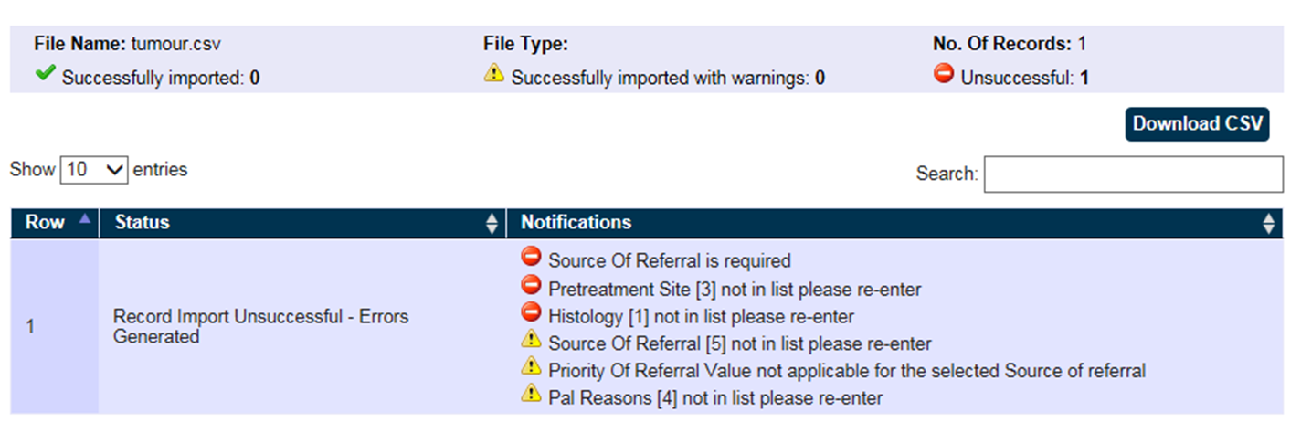
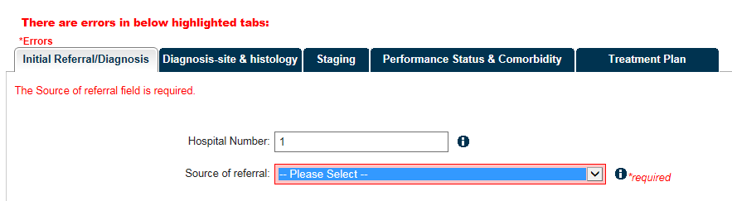
Validation
Notes:
EXAMPLES OF VALIDATION WHICH PROMOTES DQ

Slide 9
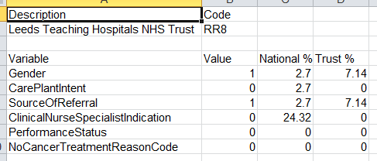
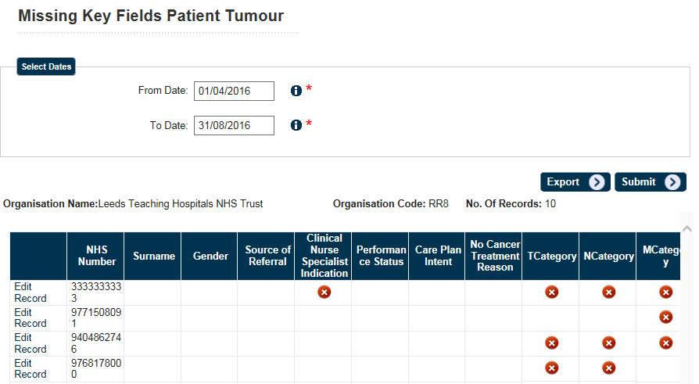
CAP Reports
Some are on screen and allow you to click through to edit.
Some are .csv exports which might just show you the data back or may do some calculations as above to show performance against others.
Notes:
We are looking at more, to enable users to self-serve – getting data quality information
Also publish GP practice level reports in CAP – unique to GP practices, secure and contains clinical info unique to practice.
OG – Combined Gen. Overall summary, management information style report, also has HES data and calcs. For case ascertainment. All data in CAP under national figures. Answers audit questions – summary for unit (surgical outcomes, gives view of how you compare to standards e.g. % of lymph nodes extracted). .csv download and print view.
Calcs and feeding back clinical info.

Slide 10
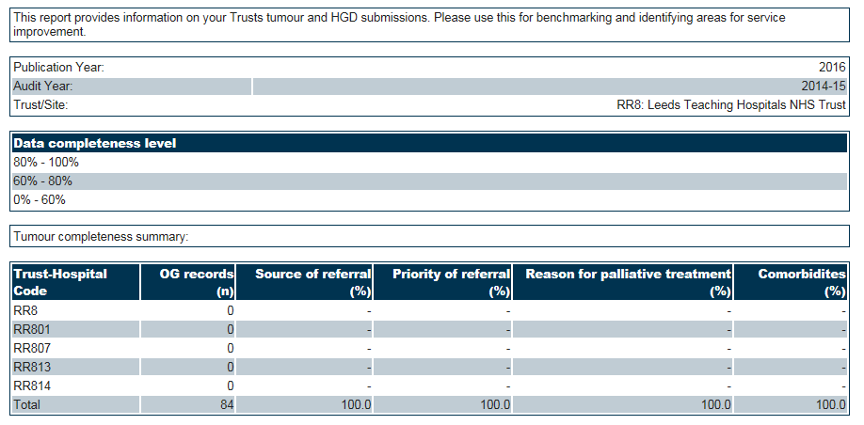
Notes:
Data completeness – can be used for benchmarking and identifying areas for service improvements. Shows the key audit data items and how they are performing entry wise against this. Again to drive up DQ.

Slide 11
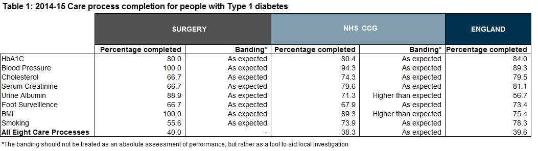
Outputs to support quality improvement
Platform drives up data quality, which in turn allows us to support quality improvement:
Local action plans and local trust reports
OG – clinician check reports for Clinical Outcomes programme
Diabetes - interactive spreadsheet and RCGP toolkit
Notes:
Platform collects the data which then allows us to support QI – the higher the data quality, the more reliable to use for QI.
The data we collect in CAP then supports the provision (via IT) of other tools. As well as the annual reports, there are other things we can produce from the data (examples above).
Local action plans – e.g. one published for OG, lists the recommendations, suggested actions and gives you a template you can then work with locally – acts as a summary of the main report.
Interactive spreadsheet – you can select your CCG and see how it is performing against national level. This helps with local improvement, gives an idea of performance e.g. banding for how your CCG is doing and how you compare to target achievements (is blood pressure where is should be?).
RCGP toolkit is almost launched, this is a web-based tool that will be making use of the data we have collected for NDA.

Slide 12
Barriers and facilitators
Barriers – not a ‘one size fits all’
Adding more reports with audit info in e.g. measures (like OG)
More guidance and support on interpreting reports so can get more out of it
Report enhancements – visual, interaction with data, making it easier to use data
Registration process – making easier to access
Ongoing engagement
Notes:
Barriers – variety of our users and clinicians. What people want is different so can’t assume a one size fits all, but also want a consistent and recognisable platform.
Variety of who can contribute to the quality improvement, variety in who commissions and who supports different audits.
Barrier – different audit / registry / collection purposes. Challenges to our particular audits e.g. cancers audits don’t have defined process as the treatments and outcomes are then used to assess. So we must understand what is useful per audit and not make assumptions.
Reporting – exploring with users and clinicians what they want from reporting.
Ongoing engagement - user group workshops, audit mailboxes, survey, day to day working – everything we hear we feed into dev.
Understanding our users and what will make their life easier – not designing if from NHS Digital, actually working with the users and testing things out. We’ll develop our roadmap from this. We have heard that our registration process needs to improve, that our reporting is useful but they’d like to see more from it.

Slide 13
Final thought
IT is a facilitator to quality improvement
IT needs to be easy to use so collecting data and getting good quality is straightforward
What is vital is what we then do with the data we have collected and how we act on the information

Slide 14

Questions
Please visit us afterwards if you’d like a demo of CAP or have any detailed questions.

